Slide 1
Recalibrating Fully Convolutional Networks with Spatial and Channel ‘Squeeze & Excitation’ Blocks
Capstone Project On
Prepared By-
Aryaman Vikram Todi (20EE38033)
Satyabrata Pradhan (23EE65R20)
Aman Soni (23EE65R02)
Signal Processing and Machine Learning
Department of Electrical Engineering
Indian Institute of Technology Kharagpur

Slide 2
Introduction
The convolutional layer captures local spatial patterns along all the input channels.
The feature maps jointly encode spatial and channel information.
The effectiveness of channel attention for image classification was shown in ILSVRC 2017 [5].
We aim to demonstrate the effectiveness of channel as well as spatial attention using the spatial and channel squeeze and excitation (scSE) block.
The U-Net [3] has been used as the base architecture.

Slide 3









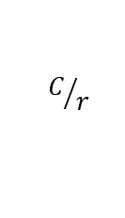

Concurrent Spatial and Channel Squeeze and Excitation
C
C
$$∗_{1×1}^{1}$$
H
⊙
$$σ$$
H
H
$${\hat{U}}_{sSE}$$
Spatial
Repeat
C
C
W
W
W
$$∗_{1×1}^{C/r}$$
$$∗_{1×1}^{C}$$
$${\hat{U}}_{scSE}$$
H
U
C
C
H
W
C
$$C/r$$
⊙
W
C
Global Average Pooling
$$σ$$
H
H
$${\hat{U}}_{cSE}$$
1
Element Wise Maximum
1
1
1
Channel
Repeat
1
1
W
W
$∗_{m×n}^{p}$ 2D convolution with $m×n$ kernel and $p$ output channels
ReLU
$σ$ Sigmoid

Slide 4
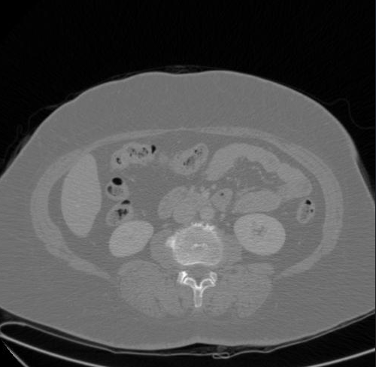

























U-Net
$$∗_{3×3}^{16} ||⋅||$$
$$∗_{3×3}^{16} ||⋅||$$
$$X_{1}$$
$$skip connection$$
$$1×512×512$$
$$16×512×512$$
$$16×512×512$$
X
$$2$$
$$2×2$$
$$max$$
$$∗_{3×3}^{32} ||⋅||$$
$$∗_{3×3}^{32} ||⋅||$$
$$skip connection$$
$$X_{2}$$
$$16×256×256$$
$$32×256×256$$
$$32×256×256$$
$$2$$
$$2×2$$
$$skip connection$$
$$max$$
$$∗_{3×3}^{64} ||⋅||$$
$$∗_{3×3}^{64} ||⋅||$$
$$X_{3}$$
$$32×128×128$$
$$64×128×128$$
$$64×128×128$$
$∗_{m×n}^{p}$ 2D convolution with $m×n$ kernel and $p$ output channels
$$2$$
$$2×2$$
$$s$$
$$max$$
$f×f$ max pooling with stride s
$$f×f$$
ReLU
$σ$ Sigmoid
||.|| Batch Normalization
$$64×64×64$$

Slide 5






















U-Net
$$skip connection$$
$$X_{3}$$
$$128×128×128$$
$$upsample 2x$$
$$∗_{3×3}^{128} ||⋅||$$
$$∗_{3×3}^{128} ||⋅||$$
$$skip connection$$
$$∗_{3×3}^{128} ||⋅||$$
$$∗_{3×3}^{64} ||⋅||$$
$$X_{4}$$
$$X_{4}$$
$$64×64×64$$
$$128×64×64$$
$$128×64×64$$
$$256×64×64$$
$$128×64×64$$
$$64×64×64$$
$$2$$
$$upsample 2x$$
$$2×2$$
$$max$$
$$∗_{3×3}^{128} ||⋅||$$
$$∗_{3×3}^{128} ||⋅||$$
$$128×32×32$$
$$128×32×32$$
$$128×32×32$$

Slide 6



















U-Net
$$∗_{3×3}^{16} ||⋅||$$
$$∗_{3×3}^{2}$$
$$skip connection$$
$$X_{1}$$
$$32×512×512$$
$$16×512×512$$
$$2×512×512$$
P
$$upsample 2x$$
$$∗_{3×3}^{32} ||⋅||$$
$$∗_{3×3}^{16} ||⋅||$$
$$skip connection$$
$$X_{2}$$
$$64×256×256$$
$$32×256×256$$
$$16×256×256$$
$$upsample 2x$$
$$∗_{3×3}^{64} ||⋅||$$
$$∗_{3×3}^{32} ||⋅||$$
$$128×128×128$$
$$64×128×128$$
$$32×128×128$$

Slide 7







SE-U-Net
$$∗_{3×3}^{16} ||⋅||$$
$$∗_{3×3}^{16} ||⋅||$$
$$X_{1}$$
$$skip connection$$
scSE
$$1×512×512$$
$$16×512×512$$
$$16×512×512$$
$$X$$
$$2$$
$$2×2$$
$$max$$
$$∗_{3×3}^{32} ||⋅||$$
$$∗_{3×3}^{32} ||⋅||$$
$$skip connection$$
$$X_{2}$$
scSE
$$16×256×256$$
$$32×256×256$$
$$32×256×256$$
$$2$$
$$2×2$$
$$skip connection$$
$$max$$
$$∗_{3×3}^{64} ||⋅||$$
$$∗_{3×3}^{64} ||⋅||$$
$$X_{3}$$
$$32×128×128$$
$$64×128×128$$
scSE
$$64×128×128$$
$∗_{m×n}^{p}$ 2D convolution with $m×n$ kernel and $p$ output channels
$$2$$
$$2×2$$
$$s$$
$$max$$
$f×f$ max pooling with stride s
$$f×f$$
ReLU
$σ$ Sigmoid
||.|| Batch Normalization
$$64×64×64$$

Slide 8






SE-U-Net
$$skip connection$$
$$X_{3}$$
$$128×128×128$$
$$upsample 2x$$
$$∗_{3×3}^{128} ||⋅||$$
$$∗_{3×3}^{128} ||⋅||$$
$$skip connection$$
$$∗_{3×3}^{128} ||⋅||$$
$$∗_{3×3}^{64} ||⋅||$$
$$X_{4}$$
$$X_{4}$$
scSE
scSE
$$64×64×64$$
$$128×64×64$$
$$128×64×64$$
$$256×64×64$$
$$128×64×64$$
$$64×64×64$$
$$2$$
$$upsample 2x$$
$$2×2$$
$$max$$
$$∗_{3×3}^{128} ||⋅||$$
$$∗_{3×3}^{128} ||⋅||$$
$$128×32×32$$
$$128×32×32$$
$$128×32×32$$

Slide 9






SE-U-Net
$$∗_{3×3}^{16} ||⋅||$$
$$∗_{3×3}^{2}$$
$$skip connection$$
$$X_{1}$$
$$32×512×512$$
$$16×512×512$$
$$2×512×512$$
P
$$upsample 2x$$
$$∗_{3×3}^{32} ||⋅||$$
$$∗_{3×3}^{16} ||⋅||$$
$$skip connection$$
$$X_{2}$$
scSE
$$64×256×256$$
$$32×256×256$$
$$16×256×256$$
$$upsample 2x$$
$$∗_{3×3}^{64} ||⋅||$$
$$∗_{3×3}^{32} ||⋅||$$
scSE
$∗_{m×n}^{p}$ 2D convolution with $m×n$ kernel and $p$ output channels
$$128×128×128$$
$$64×128×128$$
$$32×128×128$$
$$s$$
$f×f$ max pooling with stride s
$$f×f$$
ReLU
$σ$ Sigmoid
||.|| Batch Normalization

Slide 10
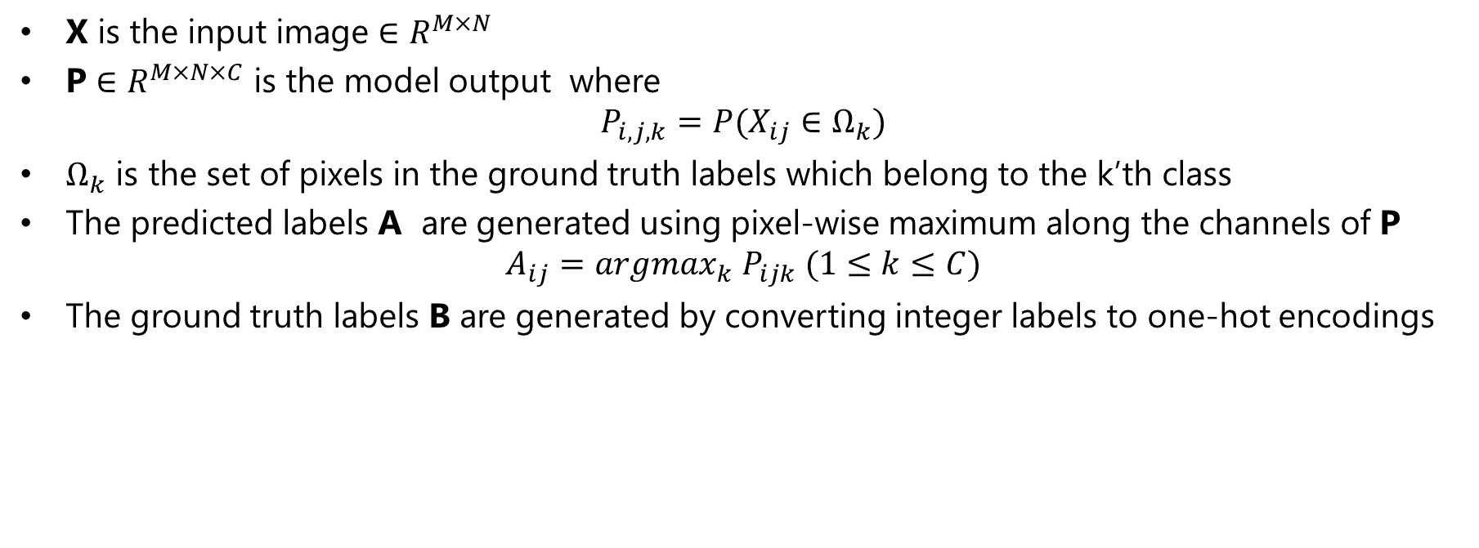
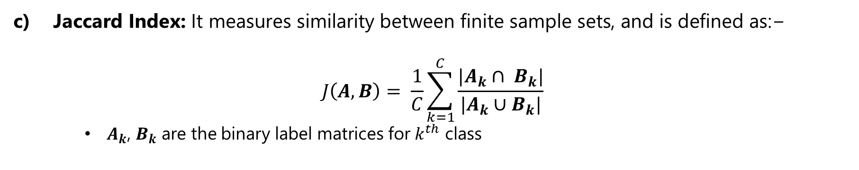
Inputs and Outputs
NETWORK
X
P
X is the input image $∈R^{M×N}$
P $∈R^{M×N×C}$ is the model output where
$$P_{i,j,k}=P(X_{ij}∈Ω_{k})$$
$Ω_{k}$ is the set of pixels in the ground truth labels which belong to the k’th class
The predicted labels A are generated using pixel-wise maximum along the channels of P
$$A_{ij}=argmax_{k} P_{ijk} (1≤k≤C)$$
The ground truth labels B are generated by converting integer labels to one-hot encodings
$\text{Jaccard} \text{Index}\text{: }\text{It} \text{measures} \text{similarity} \text{between} \text{finite} \text{sample} \text{sets}\text{, }\text{and} \text{is} \text{defined} \text{as}\text{:−}$
$$J\left(A,B\right)= \frac{1}{C}\sum_{k=1}^{C}{\frac{{|A}_{k}∩ B_{k}|}{|A_{k}∪B_{k}|}}$$
$A_{k}$, $B_{k}$ are the binary label matrices for $k^{th}$ class

Slide 11
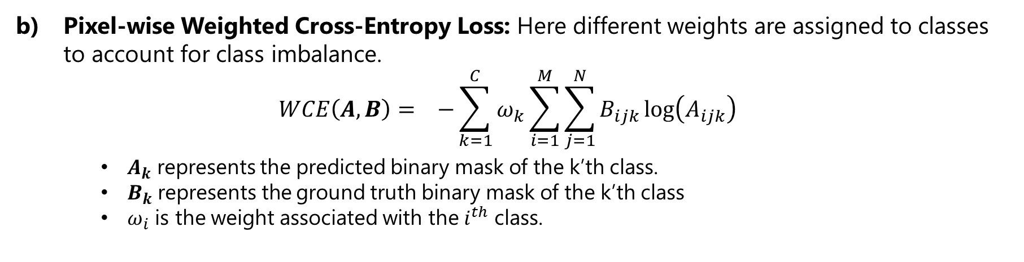
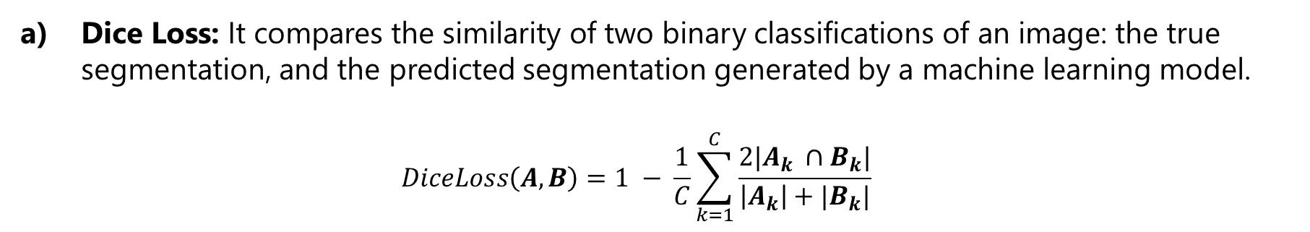
Loss Functions
Dice Loss: It compares the similarity of two binary classifications of an image: the true segmentation, and the predicted segmentation generated by a machine learning model.
$$DiceLoss\left(A, B\right)=1 − \frac{1}{C}\sum_{k=1}^{C}{\frac{2|A_{k} ∩B_{k}|}{\left|A_{k}\right|+|B_{k}|}}$$
Pixel-wise Weighted Cross-Entropy Loss: Here different weights are assigned to classes to account for class imbalance.
$$WCE\left(A, B\right)= −{\sum_{k=1}^{C}{ω_{k}\sum_{i=1}^{M}{\sum_{j=1}^{N}{B_{ijk}\log\left(A_{ijk}\right)}}}}_{}$$
$A_{k}$ represents the predicted binary mask of the k’th class.
$B_{k}$represents the ground truth binary mask of the k’th class
$ω_{i}$ is the weight associated with the $i^{th}$ class.
$\text{Jaccard} \text{Index}\text{: }\text{It} \text{measures} \text{similarity} \text{between} \text{finite} \text{sample} \text{sets}\text{, }\text{and} \text{is} \text{defined} \text{as}\text{:−}$
$$J\left(A,B\right)= \frac{1}{C}\sum_{k=1}^{C}{\frac{{|A}_{k}∩ B_{k}|}{|A_{k}∪B_{k}|}}$$
$A_{k}$, $B_{k}$ are the binary label matrices for $k^{th}$ class

Slide 12
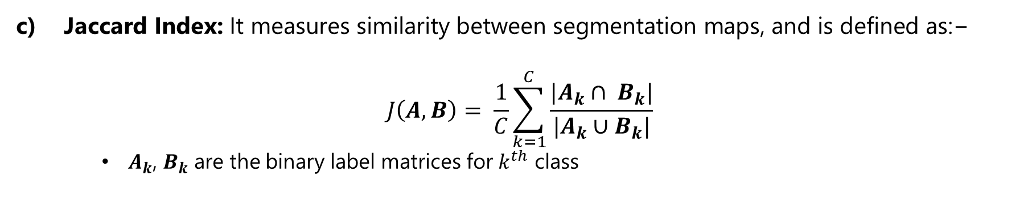
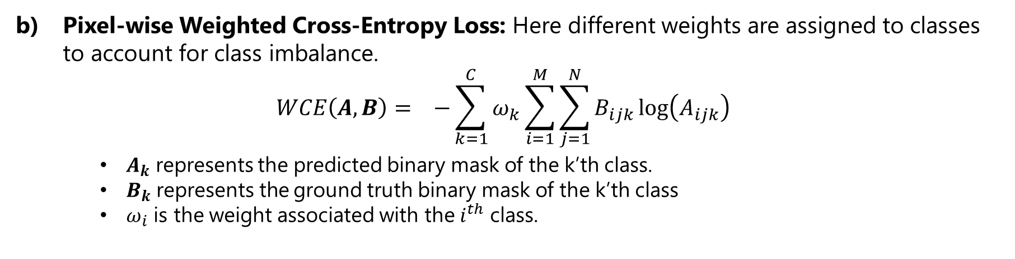
Loss Functions
Pixel-wise Weighted Cross-Entropy Loss: Here different weights are assigned to classes to account for class imbalance.
$$WCE\left(A, B\right)= −{\sum_{k=1}^{C}{ω_{k}\sum_{i=1}^{M}{\sum_{j=1}^{N}{B_{ijk}\log\left(A_{ijk}\right)}}}}_{}$$
$A_{k}$ represents the predicted binary mask of the k’th class.
$B_{k}$represents the ground truth binary mask of the k’th class
$ω_{i}$ is the weight associated with the $i^{th}$ class.
$\text{Jaccard} \text{Index}\text{: }\text{It} \text{measures} \text{similarity} \text{between} \text{segmentation} \text{maps}\text{, }\text{and} \text{is} \text{defined} \text{as}\text{:−}$
$$J\left(A,B\right)= \frac{1}{C}\sum_{k=1}^{C}{\frac{{|A}_{k}∩ B_{k}|}{|A_{k}∪B_{k}|}}$$
$A_{k}$, $B_{k}$ are the binary label matrices for $k^{th}$ class

Slide 13
Results
Model Brief
The Encoding step consists of four double convolutions blocks with Batch Normalization
The Decoder consists of four double convolution blocks with skip connections from the encoder. The activations are normalized using Batch Normalization.
The output of every double convolution block is rescaled using spatial and channel squeeze and excitation.
The output is a C- channel tensor where every pixel location consists of probability of that pixel belonging to each of the classes.

Slide 14
Results
Model Brief
The Encoding step consists of four double convolutions blocks with Batch Normalization
The Decoder consists of four double convolution blocks with skip connections from the encoder. The activations are normalized using Batch Normalization.
The output of every double convolution block is rescaled using spatial and channel squeeze and excitation.
The output is a C- channel tensor where every pixel location consists of probability of that pixel belonging to each of the classes.
Hyperparameters
All the models have been trained using the following hyperparameters:
Learning rate: 0.004
Batch Size: 20
Optimizer: Adam
Scheduler: StepLR, Learning rate is halved after every 4 epochs
Loss function: Weighted Cross-Entropy Loss + Dice Loss
The weights are computed as the inverse frequency of occurrence in the training dataset.
Model Weights are initialized with He initialization.

Slide 15
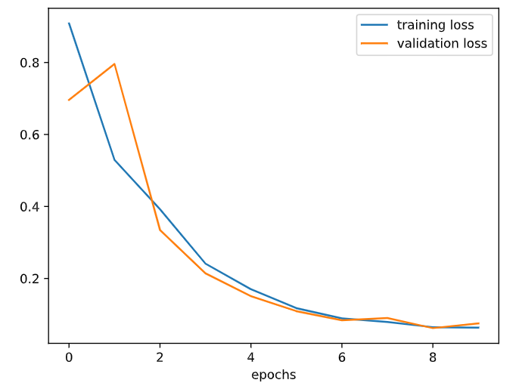
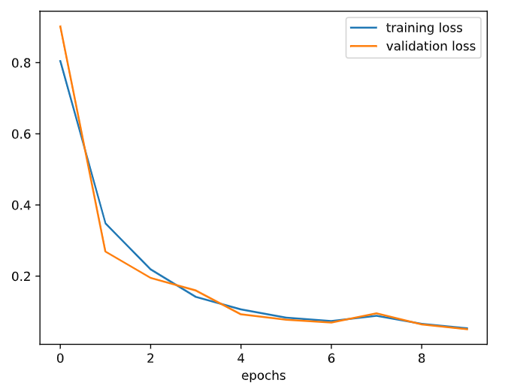
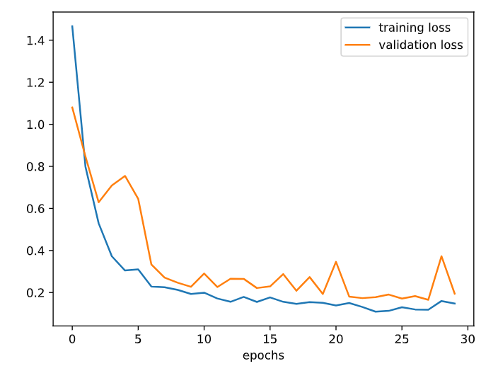
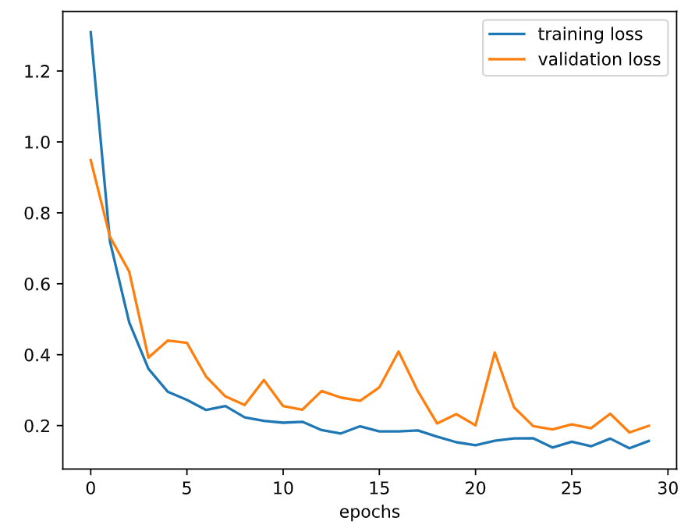
Results
Weighted Cross-Entropy + Dice Loss
Weighted Cross-Entropy + Dice Loss
Fig: CT UNet
Fig: CT SE-UNet
Weighted Cross-Entropy + Dice Loss
Weighted Cross-Entropy + Dice Loss
Fig: MR UNet
Fig: MR SE-Uet

Slide 16
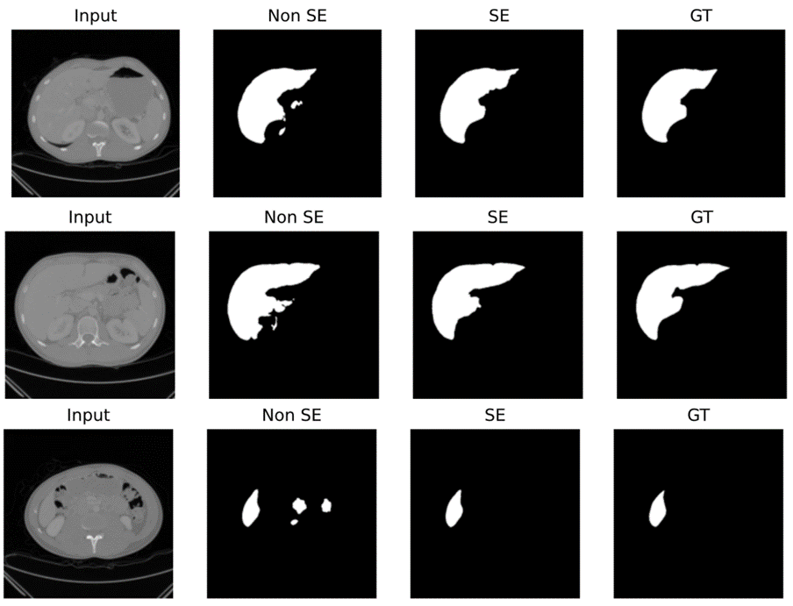
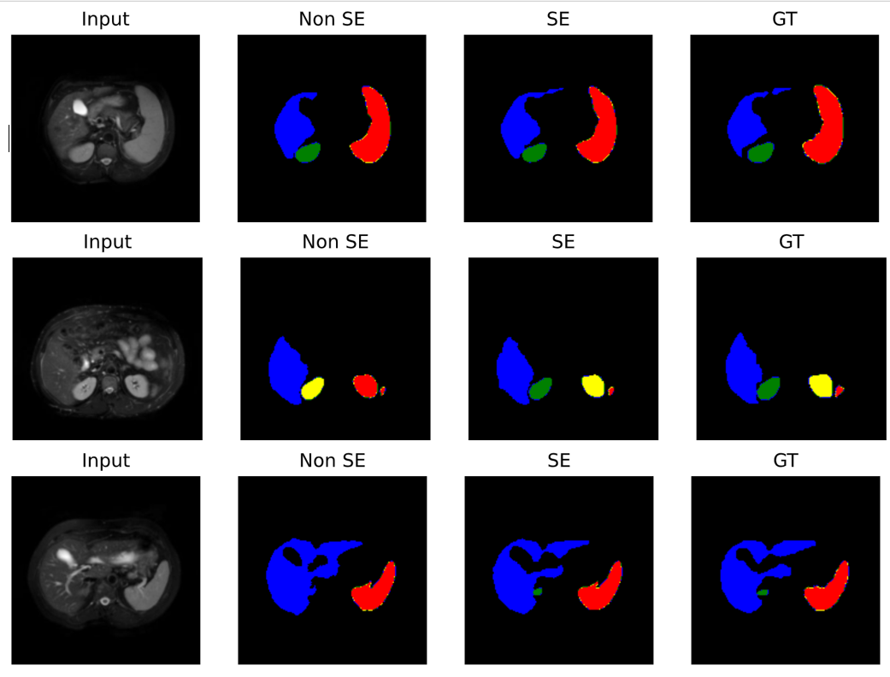
Results
Fig: Liver Segmentation Performance Comparison
Fig: Liver, Left Kidney, Right Kidney and Spleen Segmentation Performance Comparison
Liver
Spleen
Right Kidney
Left Kidney
Background

Slide 17
Performance Comparison using Jaccard Coefficient (Intersection over Union)
Results
 | CT Dataset | MR Dataset
Without scSE | 0.793 | 0.683
With scSE | 0.873 | 0.757

Slide 18
Conclusion
This demonstration indicates the ~15% improvement in the segmentation performance as measured by the Jaccard Coefficient while increasing number of trainable parameters by only ~2%.
The scSE module can be easily inserted in existing networks for segmentation due to the same input and output size.
The addition of the scSE module clearly improves the model ability to segment smaller structures.

Slide 19
References
[1]. A. G. Roy, N. Navab and C. Wachinger, "Recalibrating Fully Convolutional Networks With Spatial and Channel “Squeeze and Excitation” Blocks," in IEEE Transactions on Medical Imaging, vol. 38, no. 2, pp. 540-549, Feb. 2019.
[2]. Ali Emre Kavur, M. Alper Selver, Oğuz Dicle, Mustafa Barış, and N. Sinem Gezer, "CHAOS - Combined (CT-MR) Healthy Abdominal Organ Segmentation Challenge Data". Zenodo, 11-Apr-2019.
[3]. Ronneberger, Olaf, Philipp Fischer, and Thomas Brox. "U-net: Convolutional networks for biomedical image segmentation." Medical image computing and computer-assisted intervention–MICCAI 2015: 18th international conference, Munich, Germany, October 5-9, 2015, proceedings, part III 18. Springer International Publishing, 2015.
[4]. Kingma, Diederik P., and Jimmy Ba. "Adam: A method for stochastic optimization." arXiv preprint arXiv:1412.6980 (2014).
[5]. J. Hu, L. Shen and G. Sun, "Squeeze-and-Excitation Networks," 2018 IEEE/CVF Conference on Computer Vision and Pattern Recognition, Salt Lake City, UT, USA, 2018, pp. 7132-7141

